Slide 1
Discrete Numeric Functions
Discrete numeric functions(or numeric functions): The functions whose domain is the set of natural numbers and whose range is the set of real numbers
The sum of two numeric functions is a numeric function whose value at r is equal to the sum of the values of the two numeric functions at r.
The product of two numeric functions is a numeric function whose value at r is equal to the product of the values of the two numeric functions at r.

Slide 2
Discrete Numeric Functions
Let a be a numeric function and α be a real number. The numeric function αa is called a scaled version of a with scaling factor α.
We use |a| to denote a numeric function whose value at r = ar if ar ≥ 0, = -ar otherwise.
Let a be a numeric function and i a positive integer. We use S^{i}a to denote a numeric function such that its value at r is 0 for r = 0, 1, ..., i-1 and is ar-i for r ≧ i. And we use S^{-i}a to denote a numeric function such that its value at r is ar+i for r ≧ 0.

Slide 3
Discrete Numeric Functions
The accumulated sum of a numeric function a is a numeric function whose value at r is equal to
The forward difference of a numeric function a is a numeric function, denoted Δa, whose value at r is equal to a_{r+1}-a_{r}.
The backward difference of a numeric function a is a numeric function, denoted,▽a, whose value is equal to a₀ at 0 and is equal to a_{r}- a_{r-1} at r≧1.

Slide 4
Discrete Numeric Functions
Let a and b be two numeric functions. The convolution of a and b, denoted a*b, is a numeric function such that

Slide 5
Asymptotic Behavior of Numeric Functions
Let a and b be numeric functions. We say that a asymptotically dominates b, or b is asymptotically dominated by a, if there exist positive constants k and m such that
|br| ≦ ma_{r} for r≧k.
Intuitively, that a asymptotically dominates b means that a grows faster than b. Thus, for sufficiently large r, the absolute value of br does not exceed a fixed proportion of ar.

Slide 6
Asymptotic Behavior of Numeric Functions
asymptotically dominance
For any numeric function a, |a| asymptotically dominates a.
If b is asymptotically dominated by a, then for any constant α,αb is also asymptotically dominated by a.
If b is asymptotically dominated by a, then for any integer i, S^{i}b is asymptotically dominated by Sia.
If b and c are asymptotically dominated by a, then for any constant α and β, αb+βc is also asymptotically dominated by a.

Slide 7
Asymptotic Behavior of Numeric Functions
5. If c is asymptotically dominated by b and b is asymptotically dominated by a, then c is asymptotically dominated by a.
It is possible that a asymptotically dominates b, and b also asymptotically dominates a. For example, a_{r} = r² + r + 1, r ≥ 0 and b_{r} = 0.05r² - r - 9, r ≥ 0.
It is possible that a does not asymptotically dominate b, nor does asymptotically dominate a. For example, a_{r} =1 if r is even and a_{r} = 0 otherwise; b_{r} = 0 if r is even and b_{r} = 1 otherwise.
It is possible that a and b asymptotically dominate c, while a dose not asymptotically dominate b, nor does b asymptotically dominate a.

Slide 8
Asymptotic Growth Rate
Three notations used to compare orders of growth of an algorithm’s basic operation count
O(g(n)): class of functions f(n) that grow no faster than g(n)
Ω(g(n)): class of functions f(n) that grow at least as fast as g(n)
Θ (g(n)): class of functions f(n) that grow at same rate as g(n)

Slide 9
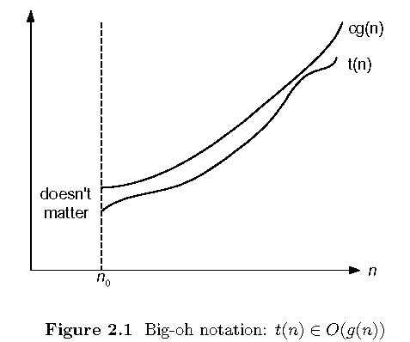
O-notation

Slide 10
O-notation
Formal definition
A function t(n) is said to be in O(g(n)), denoted t(n) ∈O(g(n)), if t(n) is bounded above by some constant multiple of g(n) for all large n, i.e., if there exist some positive constant c and some nonnegative integer n₀ such that
t(n) ≤ cg(n) for all n ≥ n₀
Example:
10n² ∈ O(n²)
10n² + 2n ∈ O(n²)
100n + 5 ∈ O(n²)
5n+20 ∈ O(n)

Slide 11
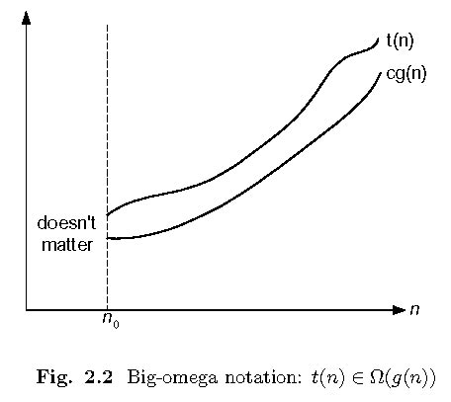
Ω-notation

Slide 12
Ω-notation
Formal definition
A function t(n) is said to be in Ω(g(n)), denoted t(n) ∈ Ω(g(n)), if t(n) is bounded below by some constant multiple of g(n) for all large n, i.e., if there exist some positive constant c and some nonnegative integer n₀ such that
t(n) ≥ cg(n) for all n ≥ n₀
Exercises: prove the following using the above definition
10n² ∈ Ω(n²)
10n² + 2n ∈ Ω(n²)
10n³ ∈ Ω(n²)

Slide 13
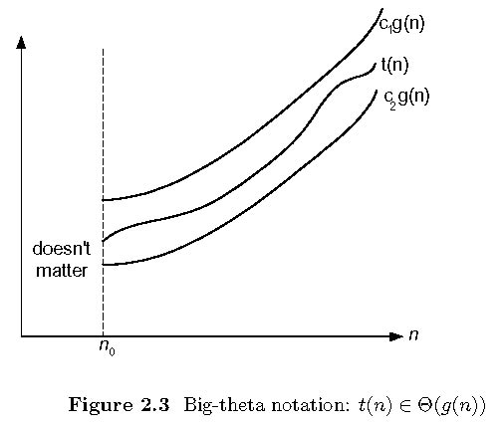
Θ-notation

Slide 14
Θ-notation
Formal definition
A function t(n) is said to be in Θ(g(n)), denoted t(n) ∈ Θ(g(n)), if t(n) is bounded both above and below by some positive constant multiples of g(n) for all large n, i.e., if there exist some positive constant c₁ and c₂ and some nonnegative integer n₀ such that
c₂ g(n) ≤ t(n) ≤ c₁ g(n) for all n ≥ n₀
Exercises: prove the following using the above definition
10n² ∈ Θ(n²)
10n² + 2n ∈ Θ(n²)
(1/2)n(n-1) ∈ Θ(n²)

Slide 15
>=
Ω(g(n)), functions that grow at least as fast as g(n)
=
Θ(g(n)), functions that grow at the same rate as g(n)
g(n)
<=
O(g(n)), functions that grow no faster than g(n)

Slide 16
Some Properties of Asymptotic Order of Growth
f(n) ∈ O(f(n))
f(n) ∈ O(g(n)) iff g(n) ∈Ω(f(n))
If f (n) ∈ O(g (n)) and g(n) ∈ O(h(n)) , then f(n) ∈ O(h(n)) Note similarity with a ≤ b
If f₁(n) ∈ O(g₁(n)) and f₂(n) ∈ O(g₂(n)) , then
f₁(n) + f₂(n) ∈ O(max{g₁(n), g₂(n)})
The analogous assertions are true for the Ω-notation and Θ-notation.

Slide 17
Some Properties of Asymptotic Order of Growth
If f₁(n) ∈ O(g₁(n)) and f₂(n) ∈ O(g₂(n)) , then
f₁(n) + f₂(n) ∈ O(max{g₁(n), g₂(n)})
Implication: The algorithm’s overall efficiency will be determined by the part with a larger order of growth.
For example,
5n² + 3nlogn ∈ O(n²)

Slide 18
Orders of growth of some important functions
All logarithmic functions log_{a} n belong to the same class Θ(log n) no matter what the logarithm’s base a > 1 is.
All polynomials of the same degree k belong to the same class: a_{k}n^{k} + a_{k-1}n^{k-1} + … + a₀ ∈ Θ(n^{k}).
Exponential functions a^{n} have different orders of growth for different a’s.
order log n < order n^{α} (α>0) < order a^{n} < order n! < order n^{n}

Slide 19
Basic Efficiency classes
The time efficiencies of a large number of algorithms fall into only a few classes.
fast
1 | constant
log n | logarithmic
n | linear
n log n | n log n
n² | quadratic
n³ | cubic
2^{n} | exponential
n! | factorial
High time efficiency
slow
low time efficiency

Slide 20
Asymptotic Behavior of Numeric Functions
For a given discrete numeric function a, let O(a) denote the set of all numeric functions that are asymptotically dominated by a. O(a) is read “order a” or “big-oh of a”.
asymptotically domination again
For any numeric function a, a is O(a).
If b is O(a),then for any constant α, αb is also O(a).
If b is O(a), then for any integer i, Sib is O(Sia).
If both b and c are O(a),then for any constant α and β, αb+βc is also O(a).

Slide 21
Asymptotic Behavior of Numeric Functions
5. If c is O(b) and b is O(a),then c is O(a).
6. It is possible that a is O(b),then b is also O(a).
7. It is possible that a is not O(b) and b is not also O(a).
8. It is possible that c is both O(a) and O(b),while a is not O(b) and b is not O(a).
Example : Let a = a₀ + a₁r + a₂r2 + ... + a_{n}rn. a = O(r^{n}).
Example : O(1) ⊂ O(log r) ⊂ O(r) ⊂ O(r^{i}) ⊂ O(k^{r}) ⊂ O(r!).

Slide 22
Asymptotic Behavior of Numeric Functions
Let A and B be two sets of numeric functions. We define
A+B={a + b|a ∈ A, b∈ B}
αA={αa|a ∈ A }
A˙B={ab|a ∈ A, b∈ B}

Slide 23
Asymptotic Behavior of Numeric Functions
1.If b is O(a), then O(b) is a subset of O(a). Consequently, if b is O(a) and a is O(b), then sets O(a) and O(b) are equal.
2.For any a, O(a)+ O(a)= O(a).
3.If b∈ O(a), then O(a)+ O(b)= O(a).
4.For any constant α,αO(a)= O(αa)= O(a).
5.For any a and b, O(a) O(b)= O(ab).

Slide 24
Asymptotic Behavior of Numeric Functions
Example : Let a = 3r3 + 2r2+ r. a is O(r³) or {3r3 } + O(r²) or {3r3 + 2 r2 } + O(r).
Note that {3r3 + 2 r2 } + O(r) ⊂ {3r3 } + O(r²) ⊂ O(r³).
Example : Let a = r + O(1/r) and b = We have ab =

Slide 25
Asymptotic Behavior of Numeric Functions
For a given numeric function a, Let Ω(a) denote the set of all numeric functions b such that there exist positive constants k and m with
|br| ≧ mar for r ≧ k.
In other words, if b is in Ω(a), then b grows at least as fast as a.

Slide 26
Asymptotic Behavior of Numeric Functions
For a given numeric function a, Let θ(a) denote the set of all numeric functions b such that there exist positive constants m, m’, and k with
mar ≦ |br| ≦ m’ar for r≧ k.
In other words, if b is in θ(a), then b grows as the same rate as a.

Slide 27
Generating Functions

Slide 28
Generating Functions
For a numeric function (a₀, a₁, a₂, ..., a_{r}, ...), we define an infinite series
a₀ + a₁z + a₂z2 + ... + a_{r}zr + ...
which is called the generating function of the numeric function a.
Example:
For a numeric function (3⁰, 3¹, 3², ..., 3^{r} ...), we define an infinite series
3⁰ + 3¹ z + 3² z2 + ... + 3^{r} zr + ...
=(3)⁰ + (3z)¹ + (3z)² + … + (3z)^{r} +…
It can be written in closed form as
1/(1-3z)

Slide 29
Generating Functions
Let a, b, and c be a numeric functions and A(z), B(z),and C(z) be its generating functions, respectively.
1. b = α a,
B(z) = αa₀ + αa₁z + αa₂z² + … + αa_{r}z^{r} + …
= αA(z)

Slide 30
Generating Functions
2. c = a + b,
C(z) = (a₀ + b₀) + (a₁+ b₁)z + (a₂+ b₂)z² + …
= a₀ + a₁z + a₂z² + … + b₀ + b₁z + b₂z₂ + …
= A(z) + B(z)
A(z) = (2+3z-6z²) / (1-2z)
= 3z + 2 / (1-2z)
= 2¹ + (2² + 3)z + 2³z² + … + 3^{r+1}z^{r} + …

Slide 31
Generating Functions
3. b_{r} = α^{r} a_{r},
B(z) = α⁰a₀ + α¹a₁z + α²a_{r}z² + … + α^{r}a_{r}z^{r} + …
= a₀ + a₁(αz) + a₂(αz)² + … + a_{r}(αz)^{r} + …
= A(αz)
4. c = ab,
C(z) = a₀b₀ + a₁b₁z + a₂b₂z² + … + a_{r}b_{r}z^{r} + …

Slide 32
Generating Functions
5. b = S^{i}a, i ≥ 0.
B(z) = 0 + 0z + … + 0z^{i-1}
+ a₀z^{i} + a₁z^{i+1} + a₂z^{i+2} + … + a_{r}z^{i+r} + …
= z^{i}A(z)
6. b = S^{-i}a, i ≤ 0.
B(z) = a_{i} + a_{i+1}z + a_{i+2}z² + … + a_{i+r}z^{r} + …
= z^{-i}(A(z) - a₀ - a₁z - a₂z² - … - a_{i-1}z^{i-1})

Slide 33
Generating Functions
7. b = Δa = S⁻¹a - a
B(z) = (1/z) (A(z) - a₀) - A(z)
or
B(z) = (a₁ - a₀)z⁰ + (a₂ - a₁)z¹ + (a₃ - a₂)z² + …
= (a₁ + a₂z + a₃z² + …) - (a₀ + a₁z + a₂z² + …)
= (1/z) (A(z) - a₀) - A(z)

Slide 34
Generating Functions
8. b = ∇a
B(z) = a₀z⁰ + (a₁ - a₀)z¹ + (a₂ - a₁)z² + …
= (a₀z⁰ + a₁z¹ + … ) - (a₀z¹ + a₁z² + …)
= A(z) - zA(z)

Slide 35
Generating Functions
9. c = a * b,
cr = ∑ i=0 a_{i} b^{r-i}
r
∴C(z) = (a₀+a₁z+…+a_{r}z^{r}+…)(b₀+b₁z+…+b_{r}z^{r}+…)
= A(z)B(z)

