Slide 1
Linux Kernel

Slide 2
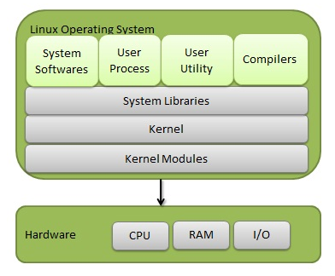
Linux System Architecture

Slide 3
Linux Operating System
Linux Operating System has primarily three components
Kernel - Kernel is the core part of Linux. It is responsible for all major activities of this operating system. Consists of various modules.
System Library - System libraries are special functions or programs using which application programs or system utilities accesses Kernel's features.
System Utility - System Utility programs are responsible to do specialized, individual level tasks.

Slide 4
Linux Kernel
Linux, Linux Kernel
Actually represented by a file on hard disk called the vmlinuz
When vmlinuz file is loaded in memory and stars running , it becomes the kernel
Most important responsibility is file management and process management
Linux Operating System, Linux Distribution, Linux System

Slide 5
Linux Kernel
Monolithic
Supports dynamic loading of kernel modules
SMP support
Linux Kernel is pre-emptive
Has thread support, but actually does not differentiate between thread and process.
Free in every sense of the word

Slide 6
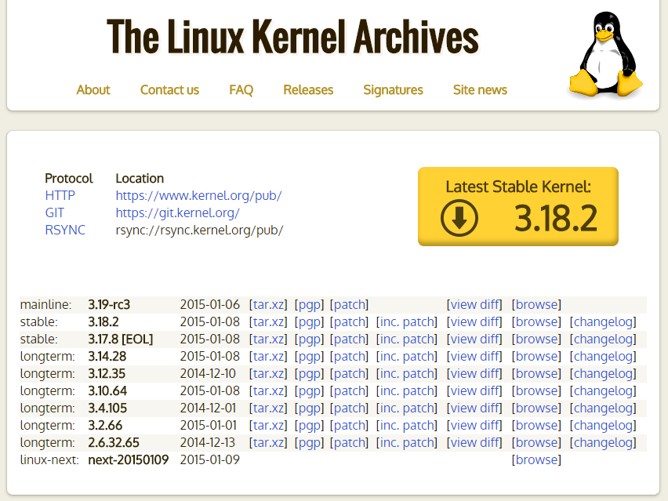
Kernel.org

Slide 7
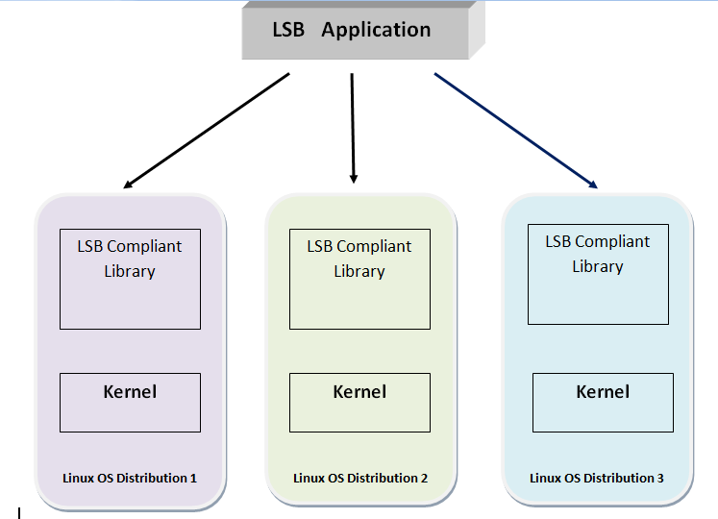
LSB

Slide 8
LSB : Objective
LSB stands for Linux Standard Base and it is standard maintainer for Linux distribution
The goal of LSB is to increase the interoperability of applications among different Linux distributions.
An application designed and developed for one LSB compliant Linux distribution, should run on every LSB compliant Linux distribution, even if ported in binary format.

Slide 9
LSB
LSB project was started in 1998 by joint effort of many Linux distributing vendors and with support of prominent figures like Linus Torvalds.
LSB is now a work group of Linux Foundation, a non-profit organization dedicated to increase the use and acceptance of open source technologies

Slide 10
LSB
LSB specifies the external behaviour the services offered by a Linux distribution, it does not impose any restriction on how the services are internally implemented.

Slide 11
OSDL
OSDL was a global non profitable organisation aimed to increase the use and deployment of Linux in industries and enterprises.
It also promotes the use of Linux in other sectors like Desktop PC, Mobile phones and Embedded systems.
It was started in the year 2000, later in 2007 OSDL merged with Free Standards Group to form ‘The Linux Foundation’

Slide 12
OSDL
Though the primary focus of OSDL was to improve and promote the use of Linux on enterprise servers, later it has formed dedicated working groups to address other key areas of potential growth :
Mobile Linux Initiative
Carrier Grade Linux
Data Centre Linux
Desktop Linux

